Slide 1
Maturity Model for Microsoft 365 Practitioners
March 2021
Emily Mancini, Sympraxis Consulting | @eemancini Marc Anderson, Sympraxis Consulting | @sympmarc
Simon Doy, iThink 365 | @simondoy
Simon Hudson, Novia Consulting | @simonjhudson
Initiative started by Sadie Van Buren as SharePoint Maturity Model in 2010

Slide 2

v
Agenda
Practitioner overview
Picture time with the Together Mode!
Introduction to the Maturity Model
Latest artifacts for the Maturity Model
Monthly Discussion
How to get more involved

Slide 3

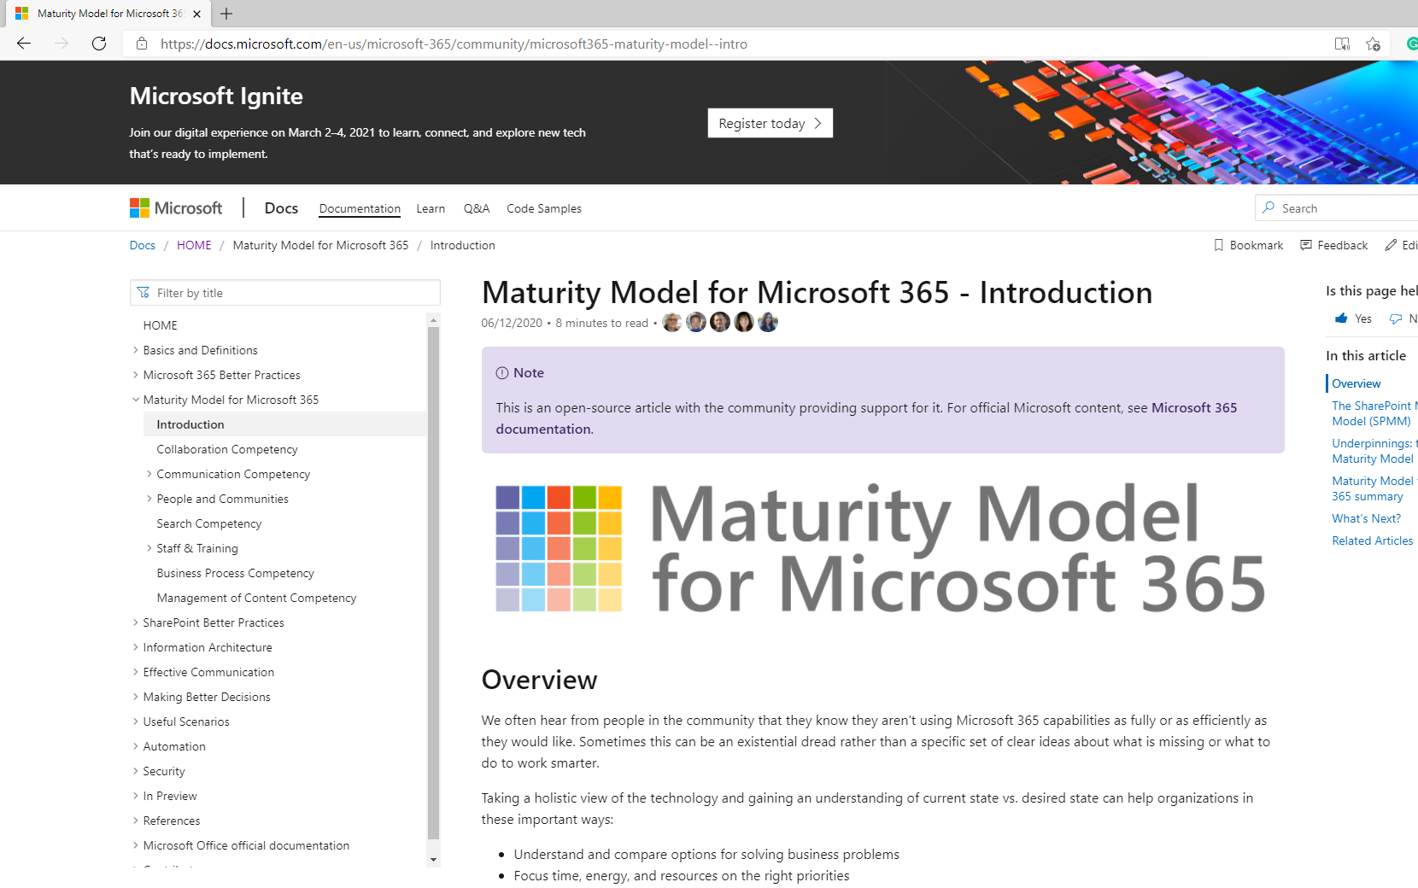
OVERVIEW
Practitioners for
Maturity Model
for Microsoft 365
https://aka.ms/sharing-is-caring

Slide 4

Practitioners of MM4M365
Safe space to hone your pitch, test your thoughts, or decide how to promote your use of the Maturity Model
Discussion-based monthly meeting
Highlights of new assets
Understanding the competencies
Mapping technology to maturity levels and competencies
Running a workshop
Measuring maturity
Sharing anecdotes and success stories
Feedback on the maturity model

Slide 5
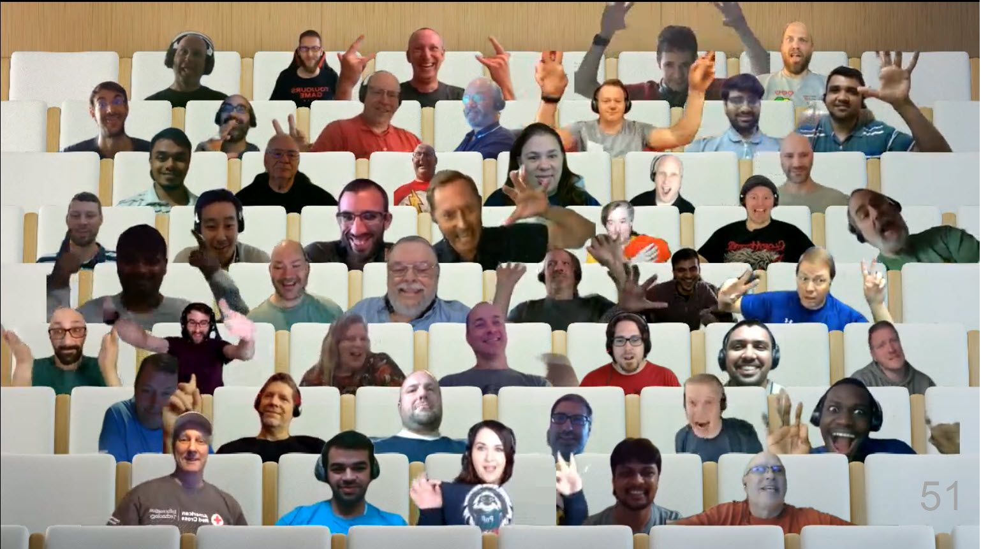

Optional picture time!
Video on and we’ll grab a Together Mode pic with those who are willing to do this.
We are together in this as a community!

Slide 6
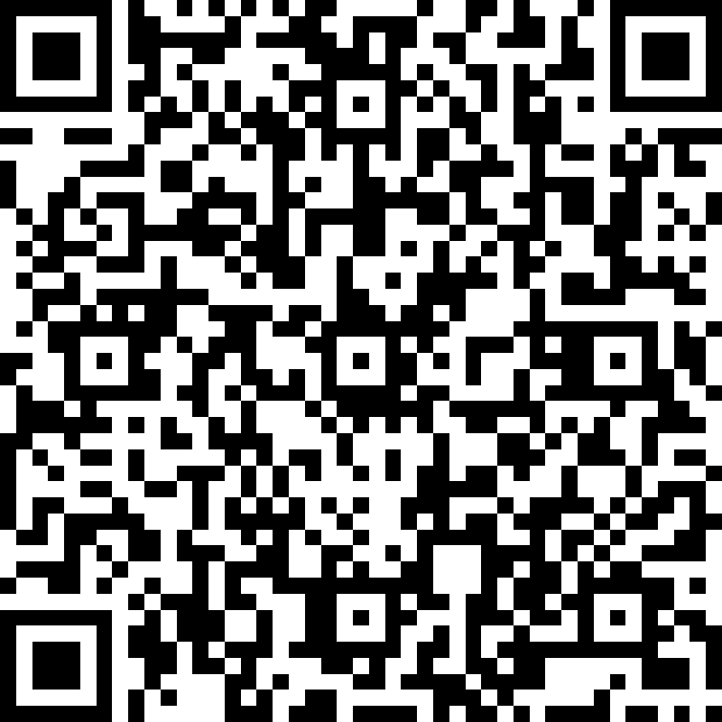
Where are you on your journey with the Maturity Model? - Heard of it but have no engaged - Scanned it a bit - Actively reading the articles - Using the Maturity Model in my org
https://symp.info/MM4M365Poll

Slide 7
INTRO
Maturity Model
for Microsoft 365
https://aka.ms/m365-community-docs

Slide 8








MM4M365 aligns the company on what can and will be done across the platform
Improve organization through use of technology
Benchmark company and department
Select appropriate approach
Develop an organizational business and technical roadmap based on:
What's possible
What's desired
Organization's culture and drivers
Lead and support strategic planning, with senior management
Align implementation needs and objectives
Discuss use of the platform with IT – not just technology
Socialization tool

Slide 9





Approach for building the Maturity Model
Non-partisan, not driven by today’s features
Led by business need, not technology features
Identifies key business and technical competencies
Evaluates current state
Applicable to various roles in the organization

Slide 10
MM4M365 has evolved with the platform
Published Competencies
Open Competencies
Supporting Articles
Business Process
Data & Analytics
Principles of…
Collaboration
Infrastructure*
Search
Communication
Communication
*In progress
Management of Content
How to elevate…
People & Communities
Communication
Search
People & Communities
Staff & Training
Staff & Training
Customization & Development

Slide 11
MM4M365 provides benchmarks to measure your organization
Maturity Level | Description | Keywords
Level 500 Optimizing | Deliberate and systematic process improvement/optimization Focus is on continually improving process performance Addressing statistical common causes of process variation and iterative process improvement | Optimal, systematic, statistical, improvement-focus, automated, assured, proactive
Level 400 Predictable | Actively managed in accordance with agreed processes and has tracked metrics Effective achievement can be evidenced across a range of operational conditions Process has been tested and refined Process users demonstrate competence | Productive, interactive, responsive, enhanced, effective, adaptable, quality
Level 300 Defined | Defined and standardized Signed off, managed process Limited validation of effectiveness, doesn’t include edge cases Process users demonstrate familiarity | Documented, policy-driven, planned, controlled, stable
Level 200 Managed | Key processes defined but not standardized, uniformly or strongly applied Some ability to demonstrate consistent outcomes Limited buy-in from staff and management Widespread inconsistency and resistance | Routine, legacy, fire-fighting, variable, personally managed
Level 100 Initial | Default, starting/exploratory state People driven processes, lacking documentation and discipline Many ways of doing the same thing (with variable results) Characterised by inefficient legacy approaches and pockets of unmanaged innovation | Ad hoc, reactive, uncontrolled, chaotic, unstable
Source: https://docs.microsoft.com/en-us/microsoft-365/community/microsoft365-maturity-model--intro

Slide 12
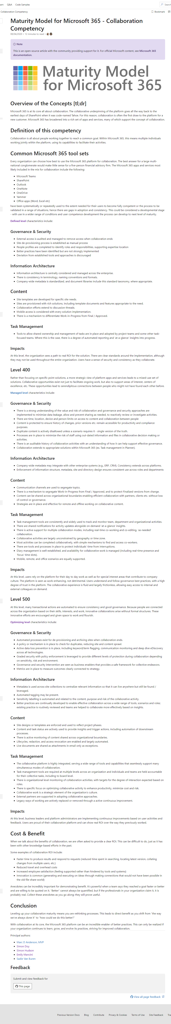
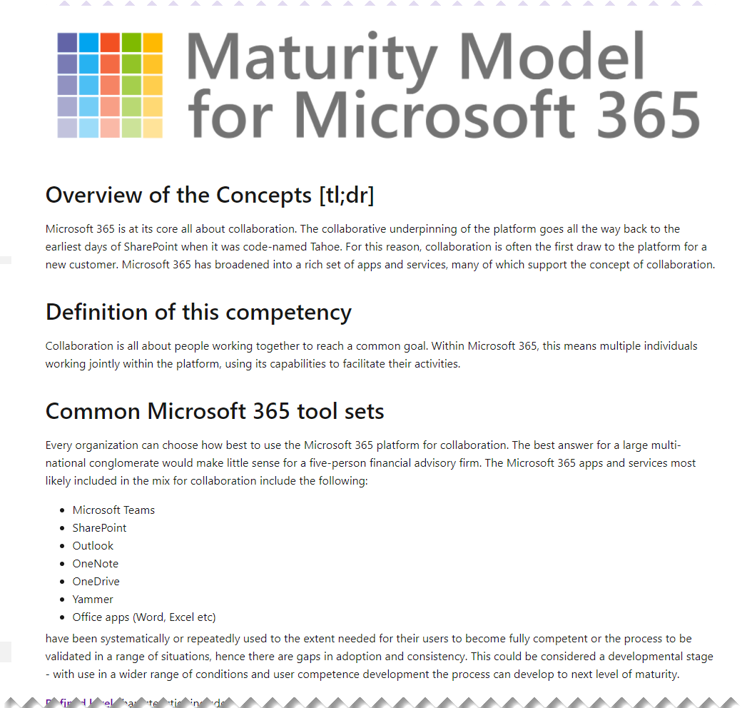
Source: https://docs.microsoft.com/en-us/microsoft-365/community/microsoft365-maturity-model--collaboration

Slide 13
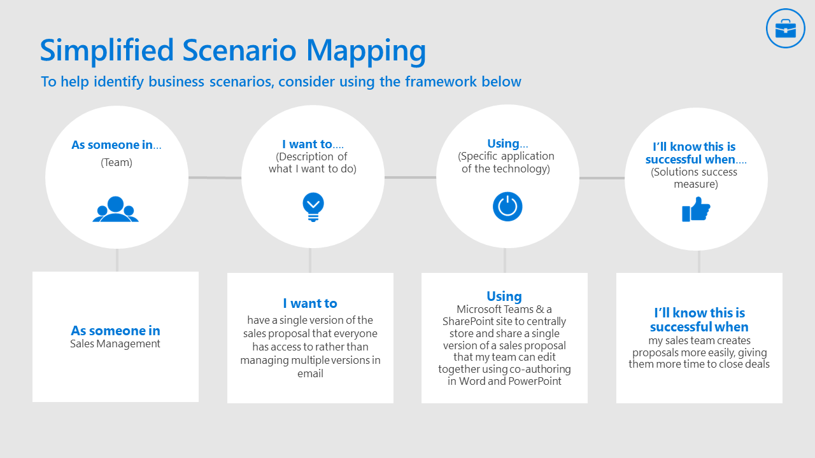
MM4M365 supports your adoption journey
Adoption Guides: https://adoption.microsoft.com/guides/
Phase 1:
Define your business strategy
Identify business scenarios
Assess readiness
Phase 3:
Encourage ongoing engagement (feedback cycles)
Office 365 Teamwork Champions: https://aka.ms/O365Champions

Slide 14
UPDATE
Latest artifacts for
Maturity Model
for Microsoft 365
https://aka.ms/m365-community-docs

Slide 15
Latest additions to MM4M365
Maturity Model Practitioners Monthly Call: https://symp.info/MM4M366Practitioners
Customization & Development: https://symp.info/MM4M365-CustomDev
Elevating Communication: https://symp.info/MM4M365ElevateComms
Maturity Model Self-Assessment: https://symp.info/MM4M365Survey

Slide 16
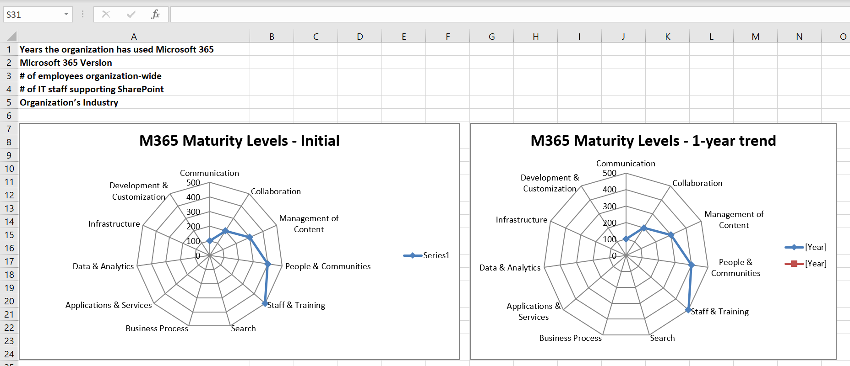
Use the self-assessment to identify your readiness

Slide 17
DISCUSSION
How you use the
Maturity Model
for Microsoft 365
https://aka.ms/m365-community-docs

Slide 18

DISCUSSION
Share reactions while others are speaking
Come off mute and share your thoughts
Share your camera, we love virtually meeting you
Raise your hand if someone is speaking

Slide 19
DISCUSSION #1:
What maturity challenges are you facing in your org?

Slide 20
DISCUSSION #2:
How are you using the Maturity Model?

Slide 21
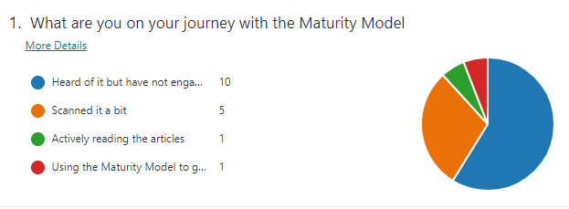
Results of today’s poll

Slide 22
DISCUSSION #3:
Do you have any feedback on the competencies of the Maturity Model?

Slide 23
MM4M365 Competencies & Artifacts
Published Competencies
Open Competencies
Supporting Articles
Business Process
Data & Analytics
Principles of…
Collaboration
Infrastructure*
Search
Communication
Communication
*In progress
Management of Content
How to elevate…
People & Communities
Communication
Search
People & Communities
Staff & Training
Customization & Development

Slide 24
DISCUSSION #4, PART 1:
What would you like to focus on in the April call?

Slide 25
DISCUSSION #4, PART 2:
Are you open to these calls being recorded?

Slide 26
DISCUSSION #5:
Are there any barriers to being involved in the Maturity Model we can help remove?

Slide 27
OVERVIEW
Get involved in the
Maturity Model
for Microsoft 365
https://aka.ms/sharing-is-caring

Slide 28
Opportunities to participate in the community
Present case study (at MMM4M365 Practitioners or other speaking opportunities)
Contribute on GitHub
Provide feedback, insights, tools, and artifacts
Socialize
content

Slide 29
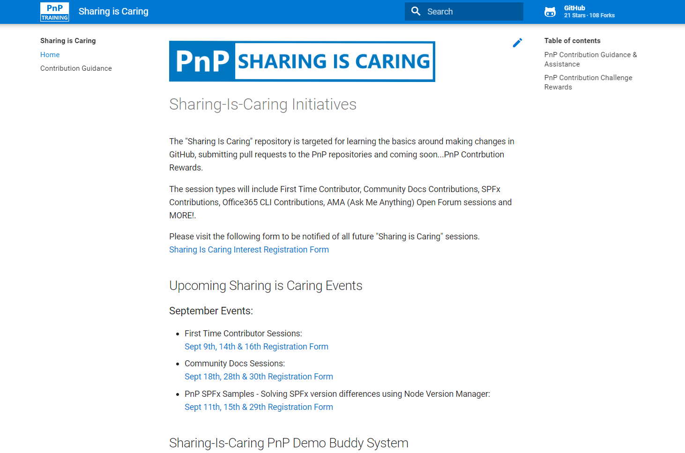

GUIDANCE
Want to get started on the open-source and community work?
Thank you, February attendees
First-Time Contributor Sessions
Monday, March 22nd 9am PST
Alok Kumar Gupta
Andy Dawson
Ashok Gopalan
Brad Chaney
Carl Abrahamson
Charles Emmanuel Saturnin Ndiaye
Charles Ndiaye
Dattatray Patil
Dinesh Bhat
Faizal Khatri
Imke Feldmann
Jeff Thorpe
Jenna Eagleson
Jim Duncan
markc
Mohammad Amer
Natalie Harzic
Patrick Galloway
Reidar Husmo
Shannon Lindsay
Tom Laciano
Vineet Desai
Anthony Kauenhowen
Dattatray Patil
Divya Akula
Mark Cho
Theresa Lubelski
Community Docs Sessions
Tuesday, March 16th 2pm PST
NEW SESSIONS: First Time Presenters Wednesday, March 24th 2pm PST
More than Code with VSCode Tuesday, March 23rd 2pm PST
https://aka.ms/sharing-is-caring

Slide 30
Thank you
Follow us on Twitter
@M365Maturity | @M365CommDocs
Take the Maturity Model Self-Assessment
https://symp.info/MM4M365-SelfAssessment
Fill out the Maturity Model Survey
https://symp.info/MM4M365Survey
Discussions in Github
https://symp.info/MM4M365Discussion
Next MM4M365 monthly call: April 20th at 7:00am PST
Third Tuesday of every month
https://aka.ms/sharing-is-caring

Slide 31


aka.ms/m365pnp

